Slide 1


East Lothian Health and Social Care Partnership
First consultation draft of a Joint Strategic Plan for East Lothian

Slide 2
^{The Strategic Plan is…}
  Required by legislation
  The “blueprint” for how the HSCP will shape and deliver services to meet national health and wellbeing outcomes for which it is accountable and shift the balance of care
  The overarching strategic document for all services in scope
  Divided into a minimum of two localities for this purpose, with the arrangements for each locality set out separately
  Required to deliver within a finite and challenging financial context.

Slide 3


^{Scope…}
  The regulations set out which health and social care functions must be delegated.
  The “must” list is limited to services provided to people over the age of 18.
  Must include adult social care, adult primary and community health care and “aspects of adult hospital care that offer the best opportunities for service redesign”.
  Other services including children’s health and social care, criminal justice and housing can also be included if there is local agreement to do so.

Slide 4
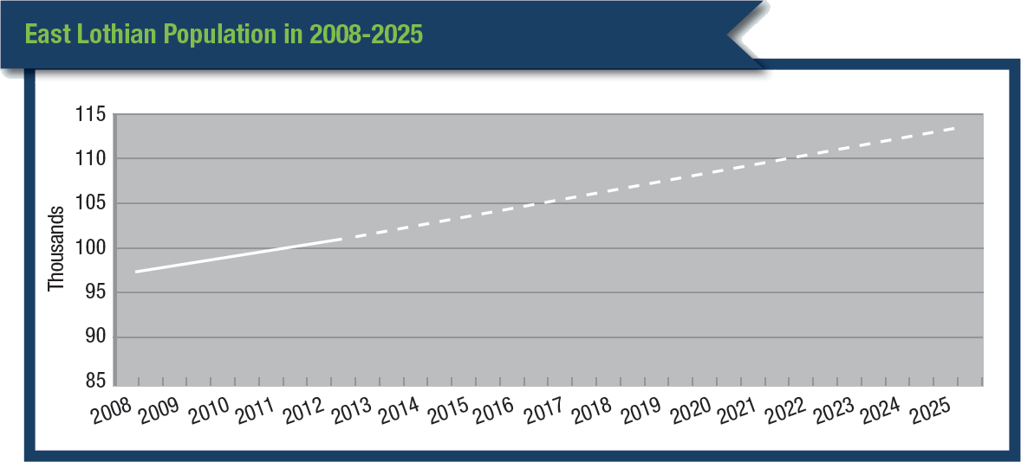
The case for change
  People with long term health conditions account for
  70% of health and care spend
  80% of GP appointments
  60% of outpatients and A&E attendances
  70% of emergency admissions
  80% of all prescribed medicines
  Long term conditions also shape elements of home care, equipment and housing support, carer support issues and long term institutional care needs.
  .

Slide 5
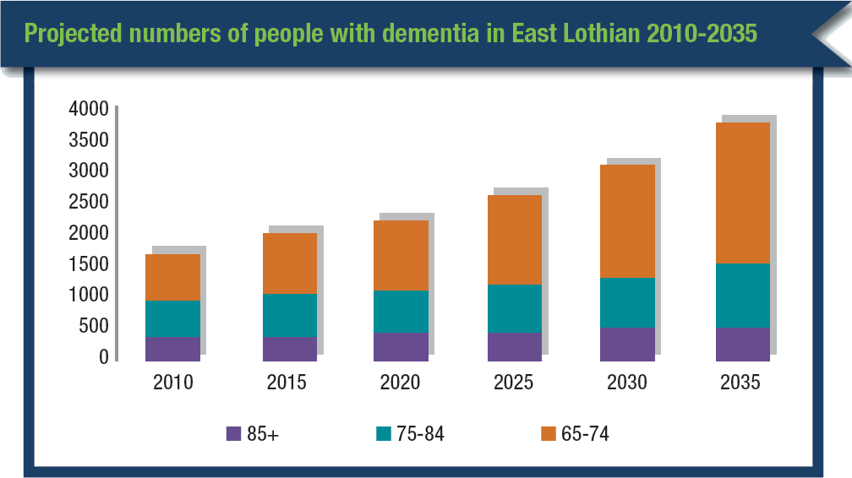

Slide 6
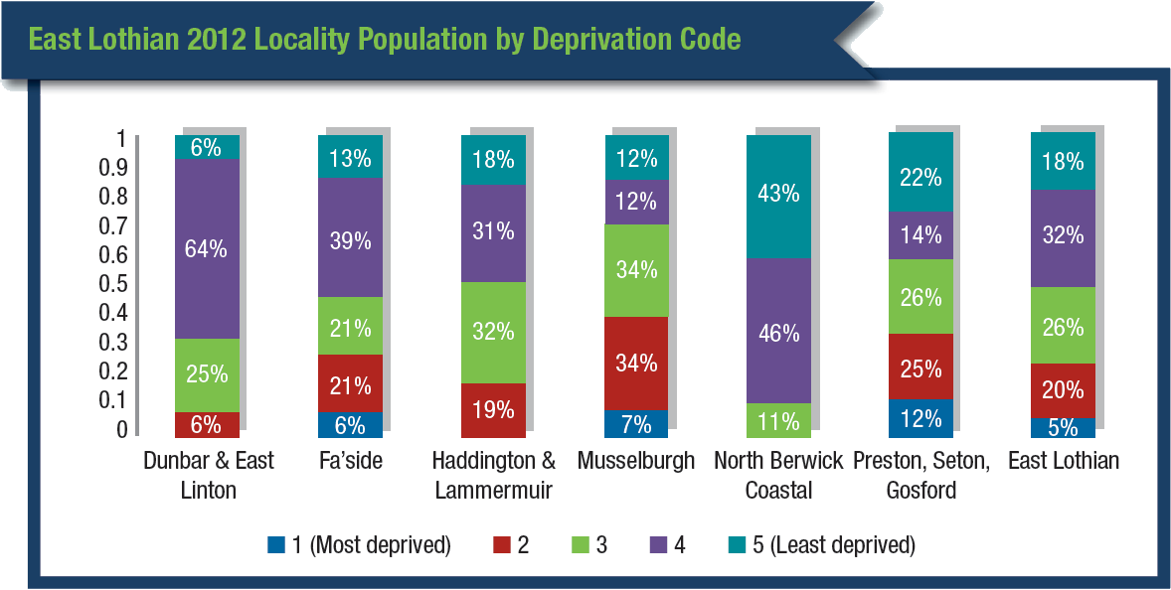

Slide 7
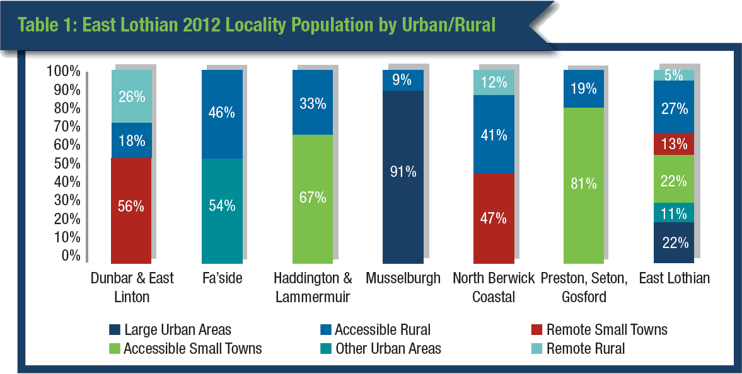

Slide 8
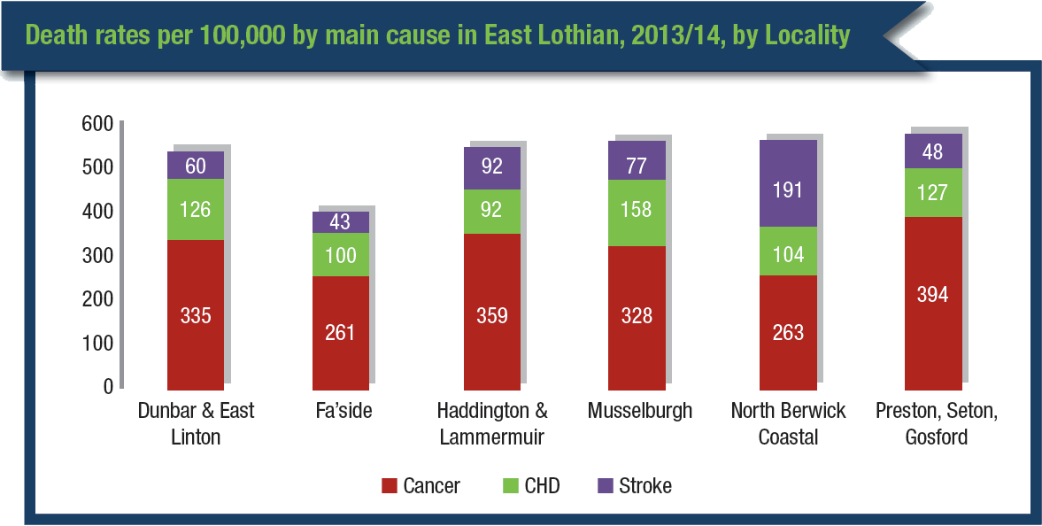

Slide 9
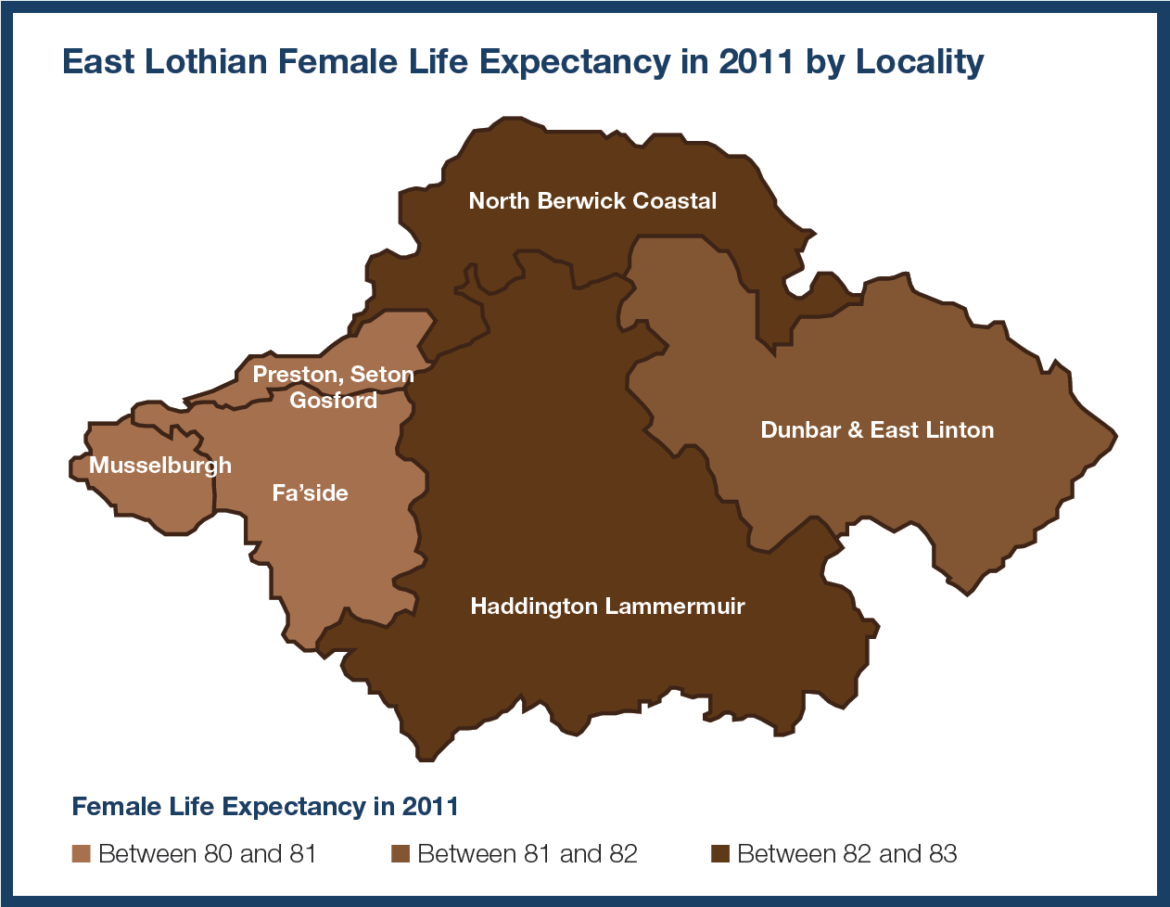

Slide 10
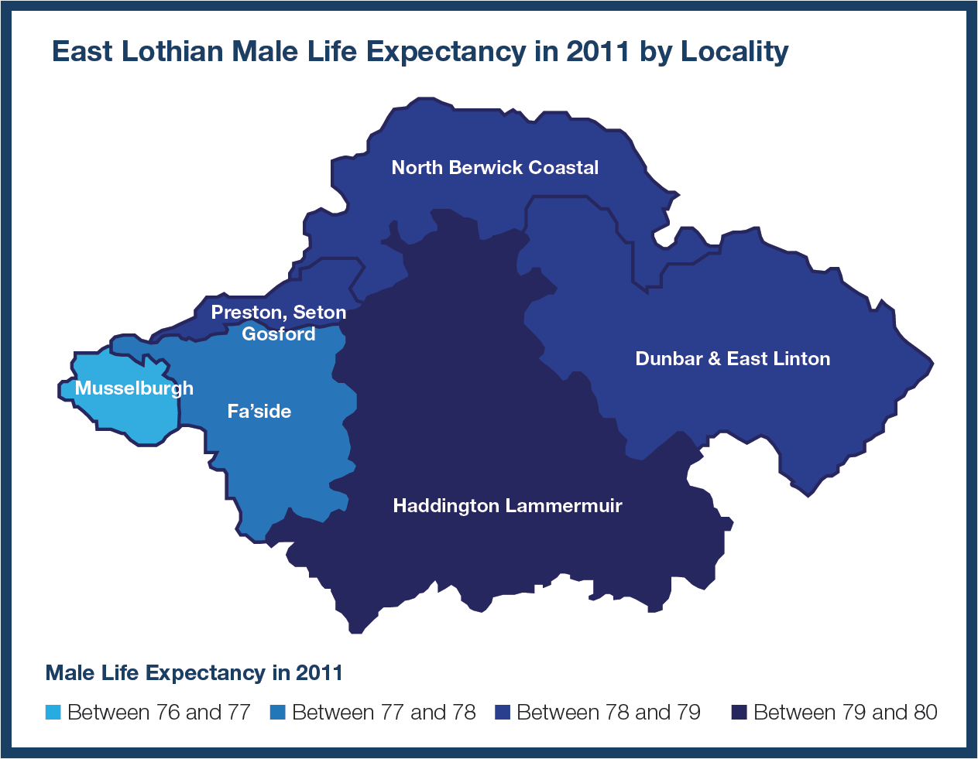

Slide 11
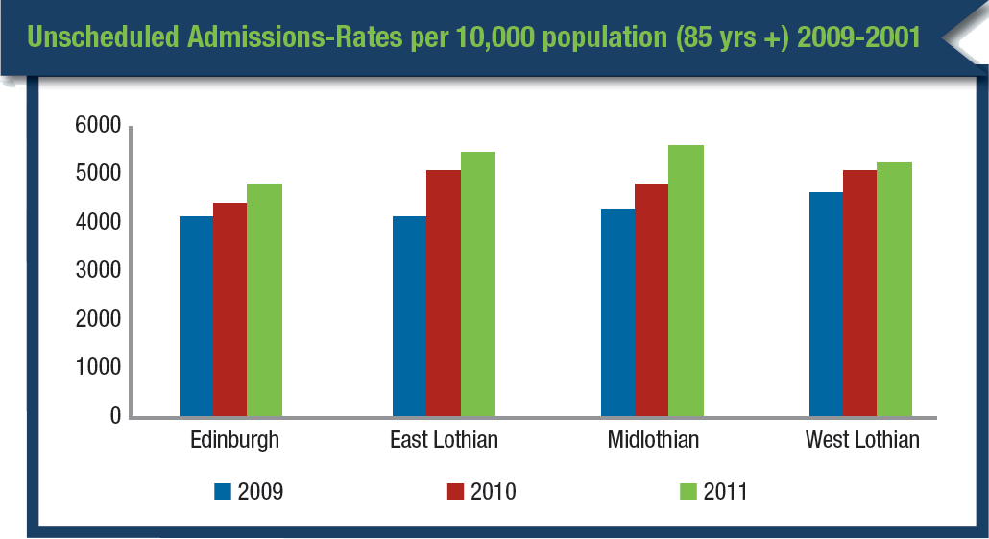

Slide 12
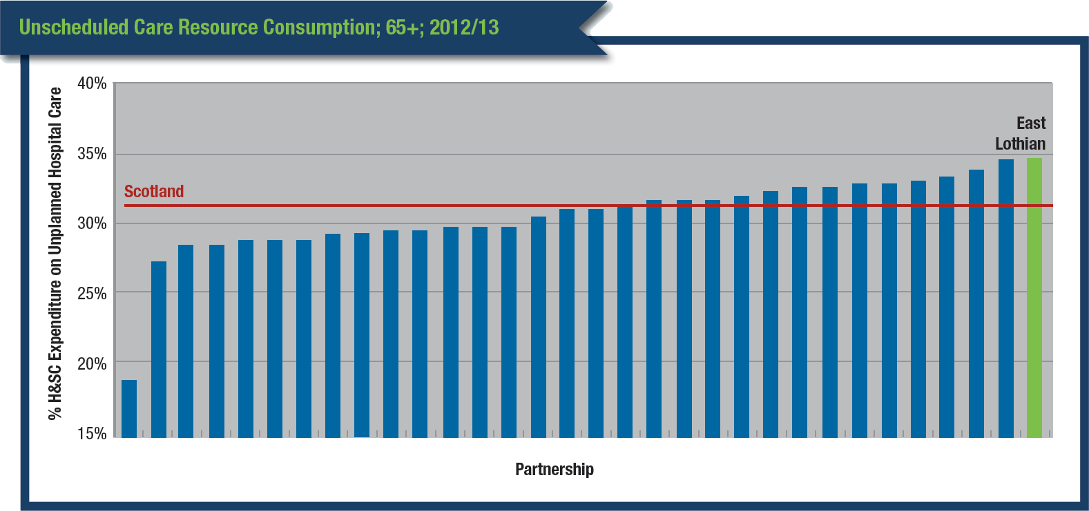

Slide 14
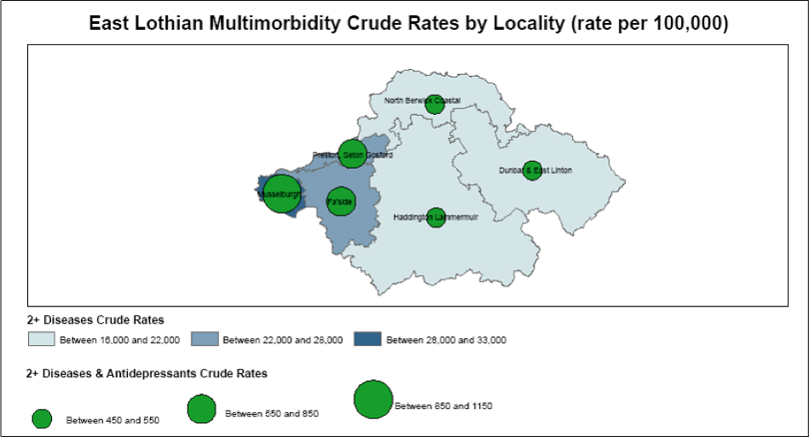

Slide 15
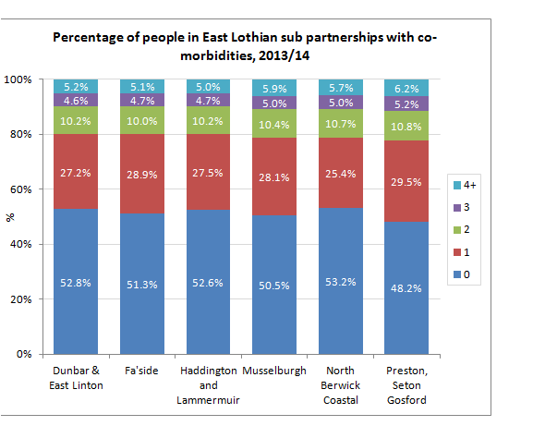

Slide 17
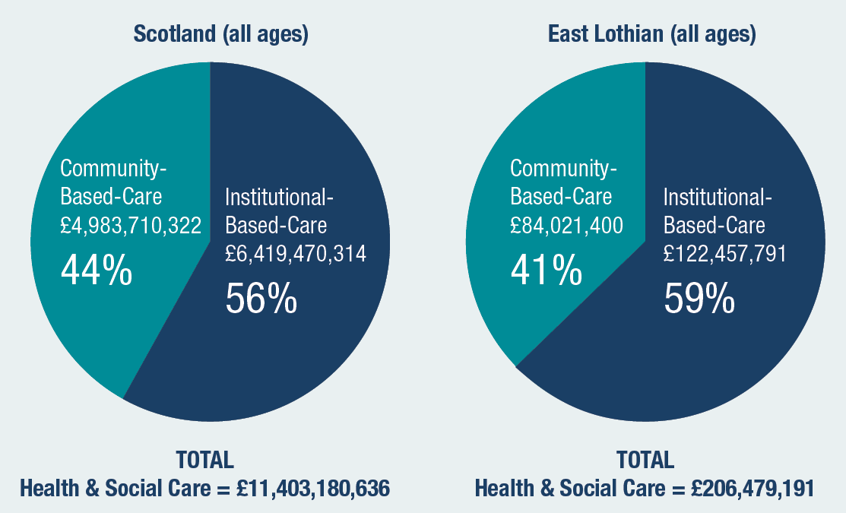

Slide 18
National health and wellbeing outcomes
People are able to look after and improve their own health and wellbeing and live in good health for longer
People, including those with disabilities, long term conditions, or who are frail, are able to live, as far as reasonably practicable, independently and at home or in a homely setting in their community.
People who use health and social care services have positive experiences of those services, and have their dignity respected
Health and social care services contribute to reducing health inequalities

Slide 19
People who provide unpaid care are supported to reduce the potential impact of their caring role on their own health and well-being.
People who use health and social care services are safe from harm
People who work in health and social care services are supported to continuously improve the information, support, care and treatment they provide and feel engaged with the work they do.
Resources are used effectively in the provision of health and social care services, without waste
National health and wellbeing outcomes

Slide 20
Planning gaps
  Dementia
  Carers
  Primary Care
  Transitions between
  services
  Anticipatory and
  preventative care
  Data and information
  sharing
  Links with Housing
  Unmet need
  Estates and beds
  Day Centres
  ……. and acute services in scope

Slide 21
And the (draft) Strategic Objectives
Our (draft) joint Strategic Plan has eight objectives aligned to national health and wellbeing outcomes:
Making universal services more accessible and developing communities
Improving prevention and early intervention
Reducing unscheduled / institutional care
Providing care closer to home
Delivering services within an integrated care model
Enabling people to have more choice and control
Improving efficiency and effectiveness
Addressing health inequalities
Consultation draft proposes four delivery programmes
Fit for the future
Care first
Enterprise
Intelligence and performance
21

Slide 22
Making universal services more accessible and developing our communities
  Develop an East Lothian Primary Care Development strategy – address demand/capacity/variation issues
  Establish EL Independent Contractors Forum - engagement, innovation , care closer to home.
  Develop a third sector Resilient Communities Assembly - key link and equal partner in planning.
  Develop and embed an access to care transport solution with our Third Sector partners.
  Work with Dementia Friendly East Lothian to establish integrated planning/support for dementia.
  Develop a local assessment and review of out of hours activity including need for minor injury provision

Slide 23
Improving prevention and early intervention
  Increase use of risk stratification and case finding at primary care and community level
  Develop GP clusters with multidisciplinary teams (“Keep Well” approach with third sector support)
  Develop more primary and community care services in our localities
  Develop an integrated falls pathway - identifies fallers at an early stage and provides a multidisciplinary, multiagency response
  Develop a Physical Activity strategy - promote role of physical activity in preventative care and promotes universal access to this.

Slide 24
Improving prevention and early intervention
  Develop a comprehensive, consistent and integrated Carers Support Pathway for East Lothian with carer identification and carer assessment as initial priority actions
  Appoint a dedicated post diagnostic support worker for Dementia.
  Develop an integrated telehealthcare strategy for East Lothian which ensures spread of technology enabled care
  Implement the local review of Day Centres in order to address capacity, capability and equity of provision

Slide 25
Promoting integrated working and choice and control
  Development of a multidisciplinary education programme for East Lothian care homes with a focus on end of life care
  Develop a model of care for care homes which supports and enhances GP practice input
  Development of joint, integrated health and social care teams, starting with the “ELSIE” team and an East Lothian mental health team.
  Carry out a review and audit of the Care at Home service framework.
  Progress negotiations on Care Home contracts.
  Increase the number of Palliative Care summaries and Key Information summaries shared with Out of Hours services.

Slide 26
Reducing unscheduled care and providing care closer to home
  Further investment in the ELSIE pathway to deliver specialist admissions avoidance care and support 24/7
  Further investment in the ELSIE pathway to deliver specialist dementia care and support
  Further investment in the ELSIE pathway to develop a dedicated integrated care home liaison team
  Pilot a Discharge to Assess system
  Deliver a new East Lothian Community Hospital which provides comprehensive, safe, quality care closer to home for the population of East Lothian.

Slide 27
Improving efficiency and effectiveness
  Commission and complete a bed modelling exercise across the total health and social care landscape to identify current and future need for provision within a quality environment.
  Commission and complete a financial exercise to better understand variation in spend and costs within the HSCP
  Commission and complete an exercise to map high resource use of health and social care services
  Develop and agree an enabling data sharing framework
  Develop a comprehensive performance
  monitoring framework

Slide 28
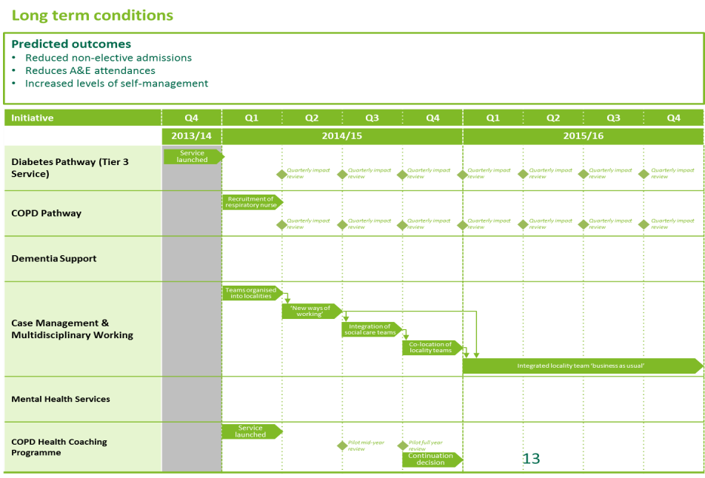
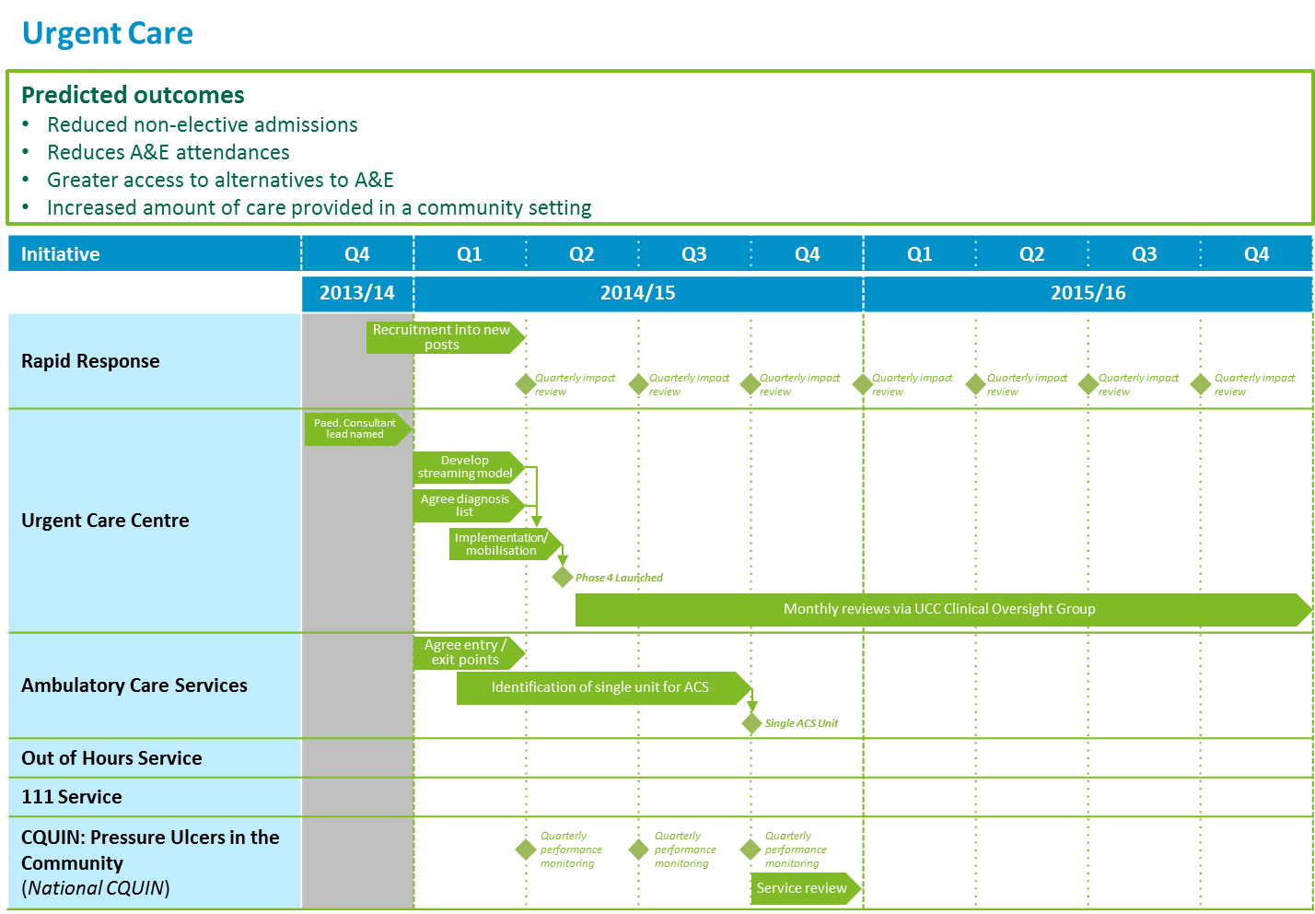
Delivery Plans to support our strategic aims and objectives
  After two rounds of consultation the Strategic Plan will be finalised. We will then develop delivery plans with key milestones for each of the priority areas outlining the key steps required in 2015/16 and 2016/17 in order to implement the individual schemes within each locality.

Slide 29
In summary our joint health and social care strategic plan will help us to deliver…
A whole-system service model which expands community-based health and social care, and improves the connections between all care providers
A proactive set of community-based services which are targeted at those who are at risk of escalating needs, and which will help to keep people out of hospital, independent and improves outcomes
A reactive set of community-based services which will be responsive for those people whose needs rapidly escalate, preventing inappropriate time in hospital and improved community-based rehabilitation and reablement
Shift and expansion of services which will bring high quality care and expertise closer to home
Strengthened relationships and governance

Slide 30
^{Questions}
Does this draft plan address the most important issues for East Lothian?
Have we missed anything that is really significant? If so, what?
We are planning to look at services in 2 localities within East Lothian. Do you agree with this approach?

Slide 31
Consultation contacts
The consultation on this draft plan will be available on East Lothian Council consultation hub at
https://eastlothianconsultations.co.uk/
and NHS Lothian Consultation zone at
http://www.nhslothian.scot.nhs.uk/OurOrganisation/Consultations/Pages/default.aspx
email to :
consultations@eastlothian.gov.uk

